Slide 1
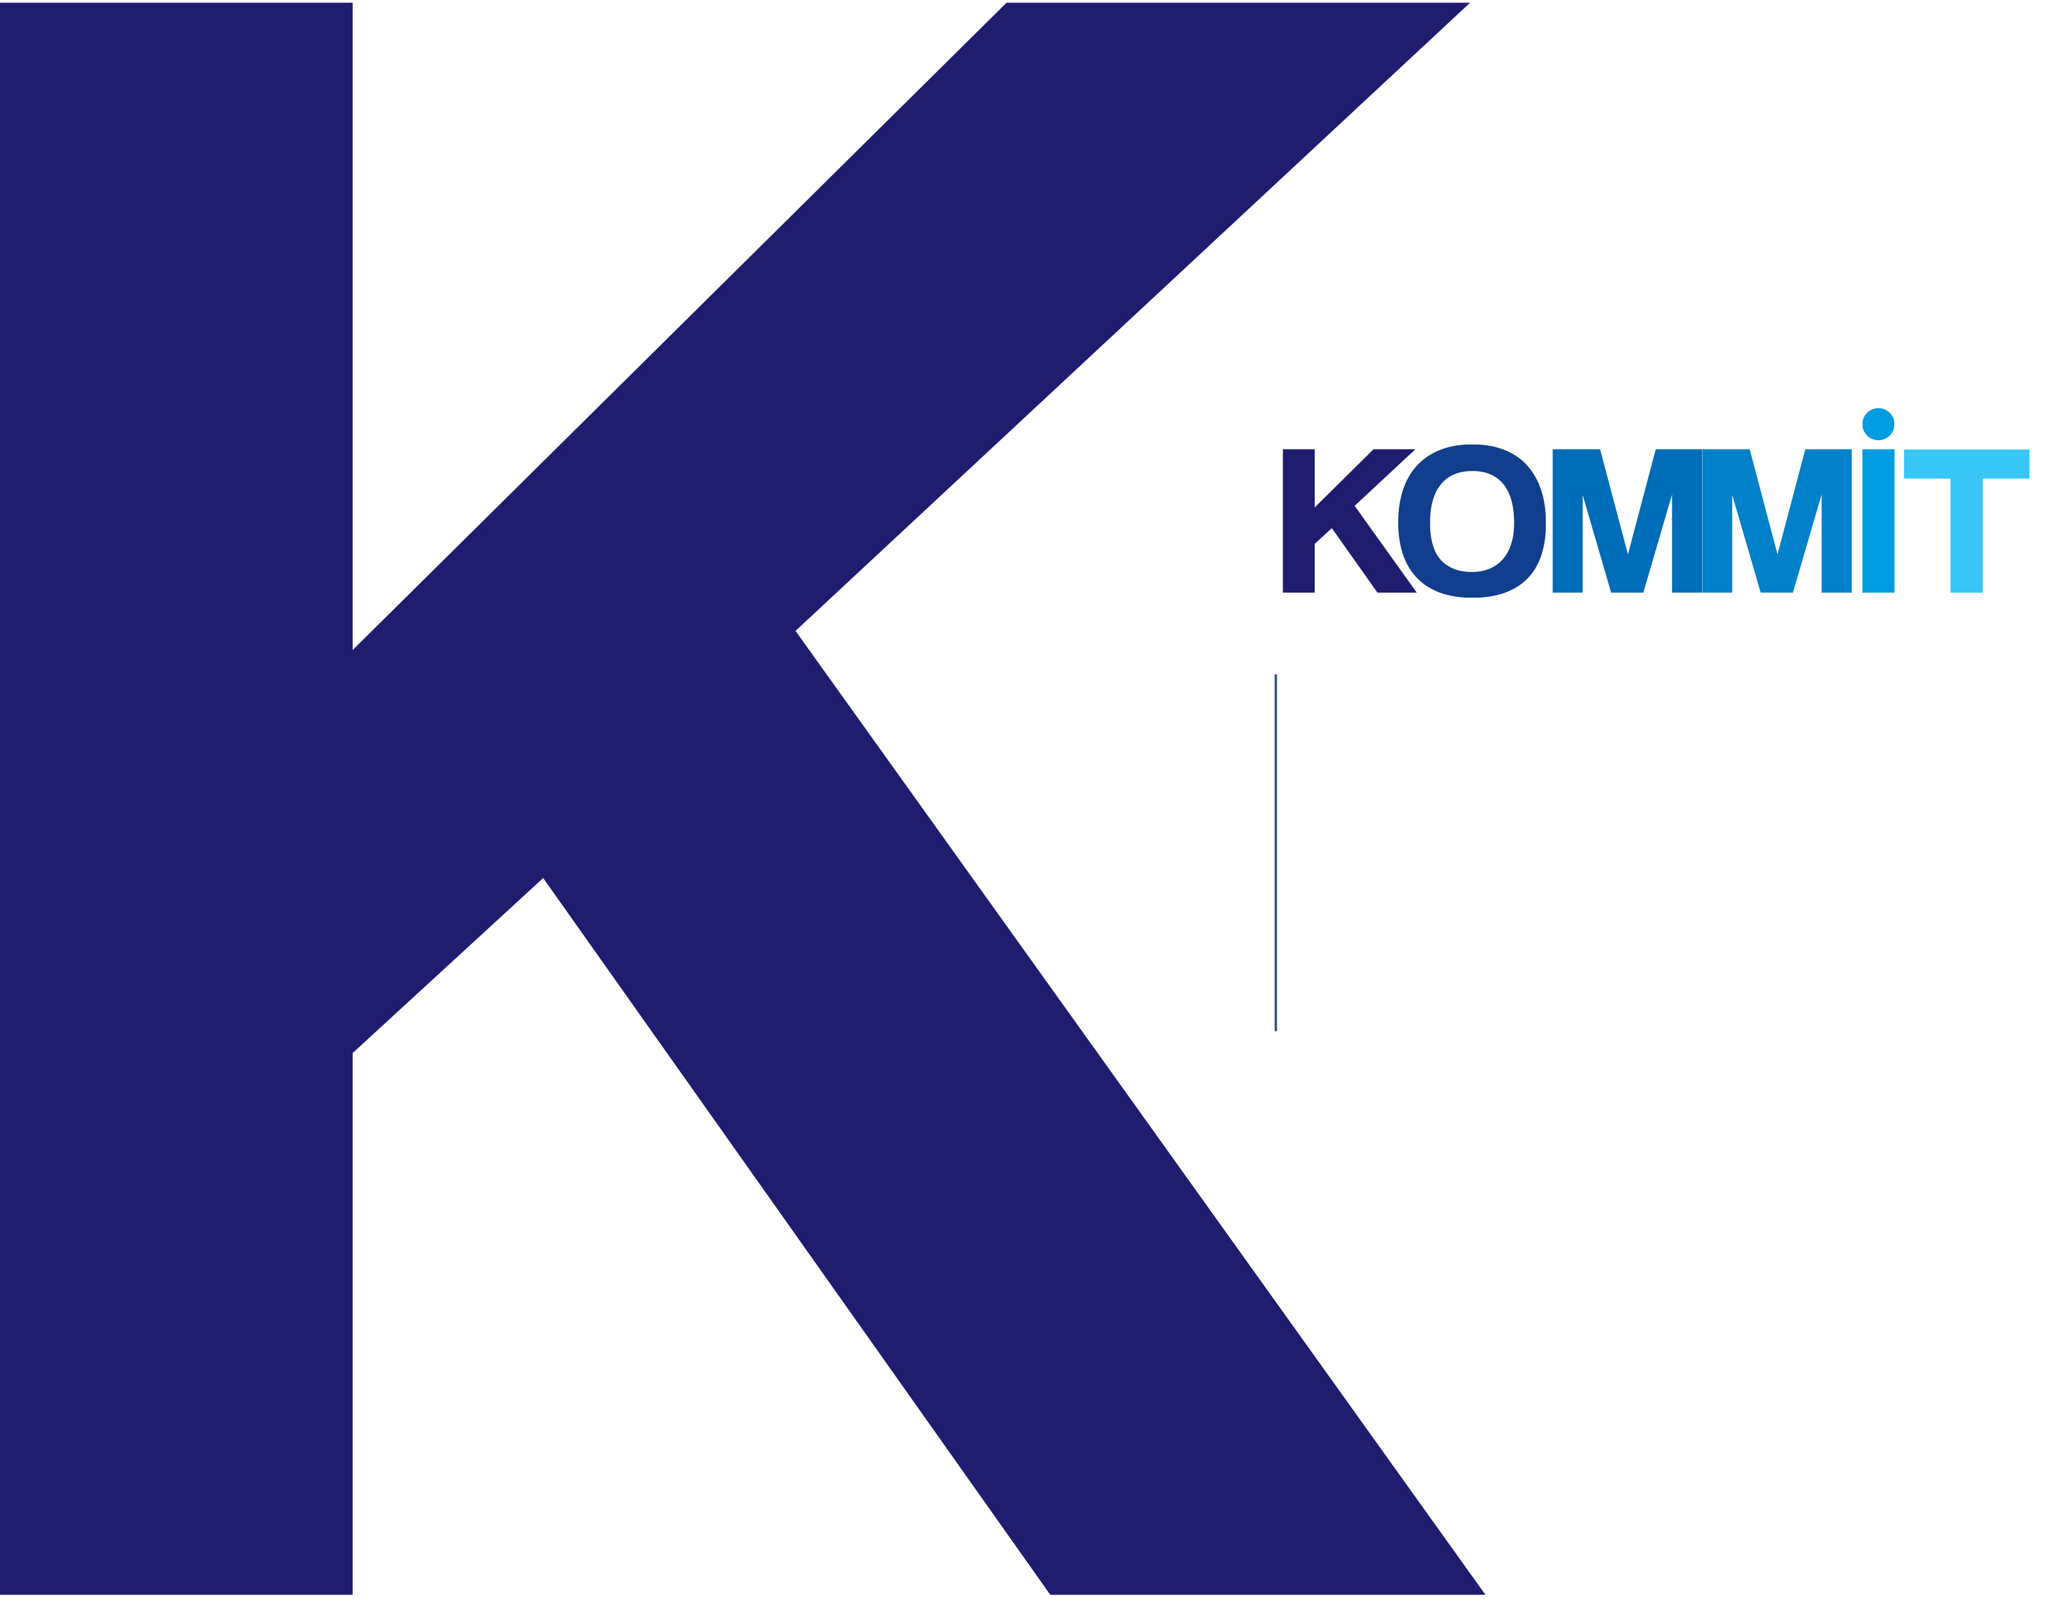
Ruby on Rails – BDD Rspec Capybara
Section 1: Introduction
alejandro@kommit.co

Slide 2

OOP concepts
Object-Oriented Programming is a programming paradigm, refers to a programming methodology based on objects, instead of just functions and procedures.
Classes: a class is template for creating objects, it provides initial values for state and implementations of behavior (methods).
Objects: an object is an entity which has features that make it different from other objects and which can execute defined actions.
The object features are known as variables or attributes
The actions are named methods or functions.
The creation of a new object is known as instantiation.
alejandro@kommit.co

Slide 3
OOP concepts
class Pencil
color = ‘yellow’
height = 10
material = ‘wood’
def write
‘write a word’
end
end
pencil = Pencil.new
pencil.write
-> ‘write a word’
alejandro@kommit.co

Slide 4
OOP concepts
Encapsulation: is the way to join in the class the features and behaviors, meaning, the attributes and methods. It is achieved by the abstraction. The encapsulations hides the state of an object restricting direct access to its components.
Abstraction: is the way to define a class by its specific features. Ex: Pencil: color, height, material… write, erase
alejandro@kommit.co

Slide 5
OOP concepts
Inheritance:
Objects are often very similar. They share common logic. But they’re not entirely the same.
Inheritance reuses the common logic and extracts the unique logic into a separate class.
The child class reuses all fields and methods of the parent class and can implement its own.
Polymorphism: is the ability of an object to take on many forms.
Comments: For example in a blog post application you can leave comments for Posts, authors, reply comments, all of them are comments but with a different type.
alejandro@kommit.co

Slide 6
Rails basics
David Heinemeier Hansson (2004)
Ruby on Rails: AKA RoR or just Rails is an open source framwork for web development in Ruby, is an object-oriented programming language based on the MVC pattern.
The main difference between Rails and other frameworks is the is the speed and ease of use, The changes made to applications are immediately applied, avoiding the time wasted doing other web development steps.
alejandro@kommit.co

Slide 7
Rails basics
Active record, an object-relational mapping layer
Action pack, a manager of controller and view functions
Action mailer, a handler of email
Action web services
Prototype, an implementer of drag and drop and Ajax functionality
A lot of Gems providing multiple services like, authentication, tests, roles, pagination, administration.
alejandro@kommit.co

Slide 8
Rails basics
https://www.airbnb.com/
https://basecamp.com/
https://bleacherreport.com/
https://www.bloomberg.com/
https://www.couchsurfing.com/
https://www.groupon.com/
https://www.kickstarter.com/
https://es.shopify.com/
https://www.slideshare.net/
https://www.strava.com/
https://www.zendesk.com/
alejandro@kommit.co

Slide 9
Ruby basics
Created by Yukihiro Matsumoto AKA Matz.
Ruby is a dynamic and open source programming language, focused on simplicity and productivity. It has an elegant syntax that is very natural to read and easy to write.
Ruby was made to be natural, not simple.
It is an interpreted language, it does not need to be compiled.
It dynamic typed, does not require to declare the variable’s type.
alejandro@kommit.co

Slide 10
Ruby basics
Where to use Ruby?
Web development: Ruby on Rails, Sinatra, etc
Mobile Apps development: RubyMotion
Desktop: JRuby
Who uses Ruby?
Mainly, Startups
Why to use Ruby?
Because its simplicity, ease to be learned and speed to build applications.
alejandro@kommit.co

Slide 11
Git basics
Linus Torvalds 2005
What is Git?
Git is a mature and actively open source version control system
You will use Git to track and manage your coding history as well as get into the programming community as a whole.
To put it another way, Git will allow you to make revisions of your work as well as others… this way you can feel assured that if you make an awful mistake to fix or have a solution for someone else, Git will be the best way to do it
Github, Bitbucket, etc
Allows coworking
Commits History and Author
Branching to easily perform environments
Easy to rollback to stable versions
https://git-scm.com/videos
https://medium.freecodecamp.org/how-to-become-a-git-expert-e7c38bf54826
alejandro@kommit.co

Slide 12
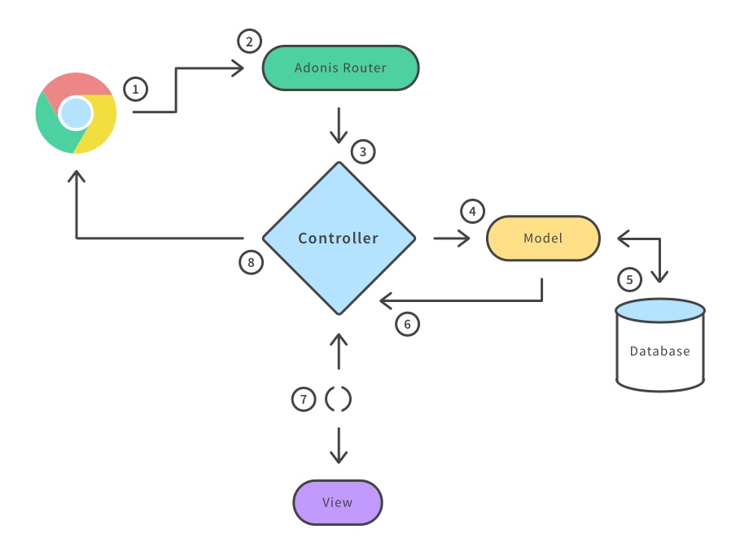
MVC
alejandro@kommit.co

Slide 13
MVC
The MVC is a software application’s architecture pattern, it separates the application in three components, Model, View and Controller.
Models are for handling data and business logic
Controllers are for handling the user interface and application
Views are for handling graphical user interface objects and presentation
alejandro@kommit.co

Slide 14
MVC
The flow for an HTTP request is described below:
The browser (on the client) sends a request for a page to the controller on the server.
The routes file determine what controller and action to call.
The controller retrieves the data it needs from the model in order to respond to the request.
The model go to the database and gets all the needed information to return it to the controller.
The controller gives the retrieved data to the view.
The view is rendered and sent back to the client for the browser to display.
alejandro@kommit.co

Slide 15
MVC
Improved scalability: (the ability for an application to grow) you could add more options to your application without affect the existent code and also improving the performance.
Ease of maintenance: all the components have low dependency of each other, making changes to one of those, does not affect another.
Reusability: you have the option to reuse a model by multiple views.
alejandro@kommit.co

